Slide 1
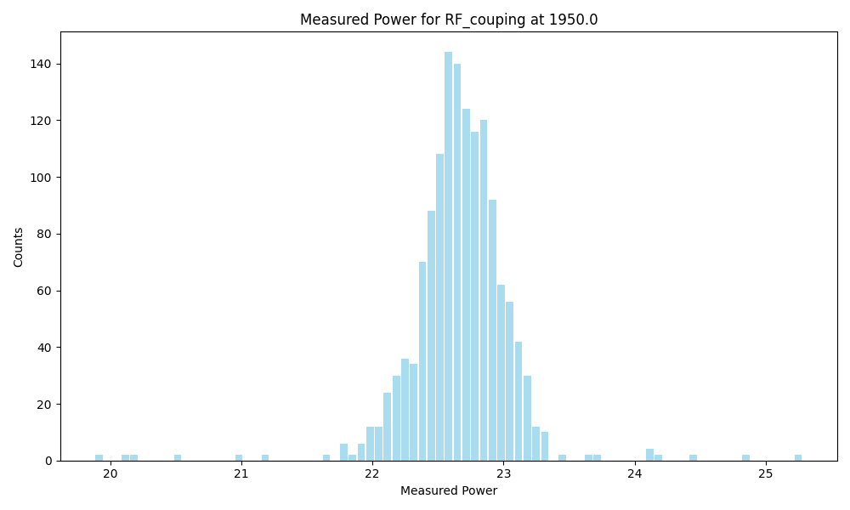
Frequency | 1950.0
Count | 1408
Mean | 22.66
Std | 0.39
Min | 19.88094
Max | 25.28123

Slide 2
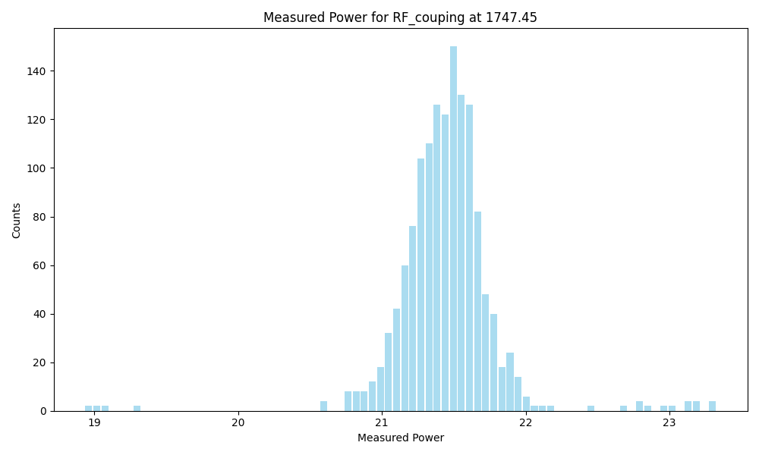
Frequency | 1747.45
Count | 1408
Mean | 21.45
Std | 0.36
Min | 18.93163
Max | 23.32776

Slide 3
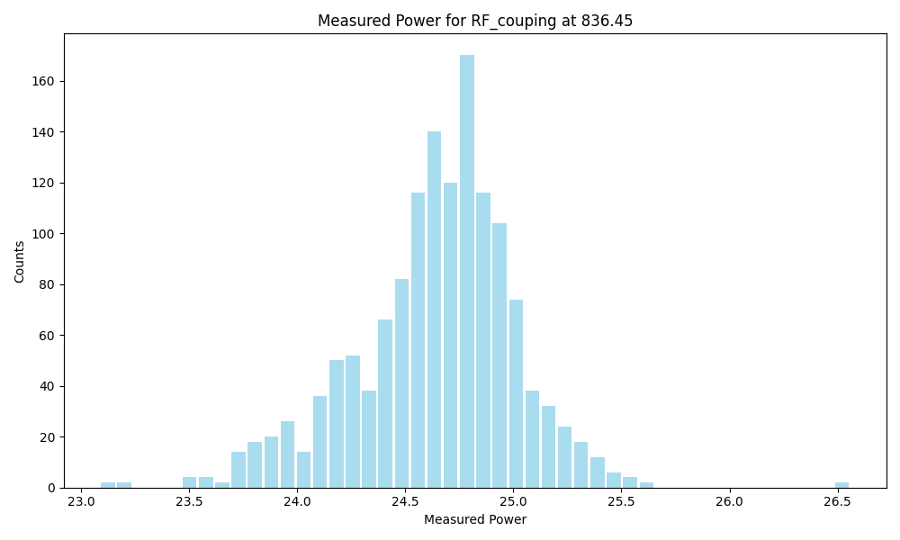
Frequency | 836.45
Count | 1408
Mean | 24.64
Std | 0.37
Min | 23.087
Max | 26.55909

